Slide 1
SDG 14- LIFE BELOW WATERSDG 14-focus Conserving and sustainably use of aquatic resources.Goal- reducing marine pollution , protecting area , regulating fishing practices.Threatened - overfishing , habitat destruction , climate change & pollution.

Slide 2
Sustainable Fisheries Practices
Fishing quotas and regulations - Set catch limits and seasonal bans to prevent overfishing and allow fish populations to recover
Selective fishing gear- Use of gear that reduces bycatch and protects juvenile fish
Marine protected areas(MPAs) – Designated zones where fishing is restricted or prohibited to conserve marine biodiversity and habitats
Sustainable aquaculture – Promoting fish farming methods that minimize environmental impact and reduce pressure on wild stocks
Community based management – Involving local fisheries and communities in decision making fosters responsibility and compliance
Certification & Eco-Labels – Program like MSC(Marine Stewardship Council) encourage sustainable practices by rewarding responsible fisheries
Monitoring & data collection – Scientific research and stock assesments guide effective policy and adaptive management

Slide 3
Fisheries and Food Security
Global Importance of Fish
• Fish is a major source of animal protein globally.
Livelihood Support
• Over 200 million people rely on fisheries and aquaculture for employment.
• Critical for coastal communities and island communities
Sustainability and Future Supply
• Overfishing, climate change, and pollution threaten fish stocks.
• Sustainable practices (e.g., marine protected areas, quotas, aquaculture) help:
• Maintain fish populations
• Ensure affordability and access
• Protect marine ecosystems

Slide 4
Fisheries in Sri Lanka
Vital Economic Sector: Contributes \~1.3% to GDP and supports over 2.7 million people.
Two Main Sub-sectors :
Marine Fisheries: Coastal and deep-sea fishing; major fish types include tuna, sardines, mackerel.
Inland & Aquaculture: Freshwater fishing in reservoirs, tanks; growing focus on shrimp and tilapia farming.
Key Fishing Zones: Northwestern, Eastern, and Southern coasts are the most active.
Exports: Tuna and shrimp are major exports, especially to EU and Japan.
Challenges: Overfishing, illegal fishing, climate change, and post-conflict recovery.
Government Efforts: Sustainable practices, gear regulations, and community-based fisheries management

Slide 5
Roles of policies and global partnerships
1) FAO code of conduct for responsible fisheries (food and agriculture organization)
Provide international standards for responsible fishing practices
Prevent overfishing and ensure long term sustainability, reduce bycatch
2) UN Convention on the Law of the Sea (UNCLOS, 1982)
Establish legal framework for marine and coastal resource use
Cooperation among states on highly migratory and shared stocks
Address illegal, unreported, and unregulated (IUU) fishing
3) National Fisheries Acts and Regulations
Enforce national-level management of fisheries based on local ecological, economic, and cultural conditions
Legally define fishing zones, gear restrictions, closed seasons, and licensing systems
Examples in practice: Restrictions on dynamite fishing, trawl bans, mesh size limits, etc
4) Regional Fisheries Management Organizations (RFMOs)
Manage shared fish stocks across multiple countries (e.g., tuna, swordfish)
Coordinate scientific research, quotas, and enforcement for sustainable harvesting
Examples: Indian Ocean Tuna Commission (IOTC)
Western and Central Pacific Fisheries Commission (WCPFC)
International Commission for the Conservation of Atlantic Tunas (ICCAT)

Slide 6
Recommendation
Improve fisheries rules and make sure they are followed
Promote community participation and education
Invest in sustainable aquaculture
Encourage regional and global cooperation

Slide 7
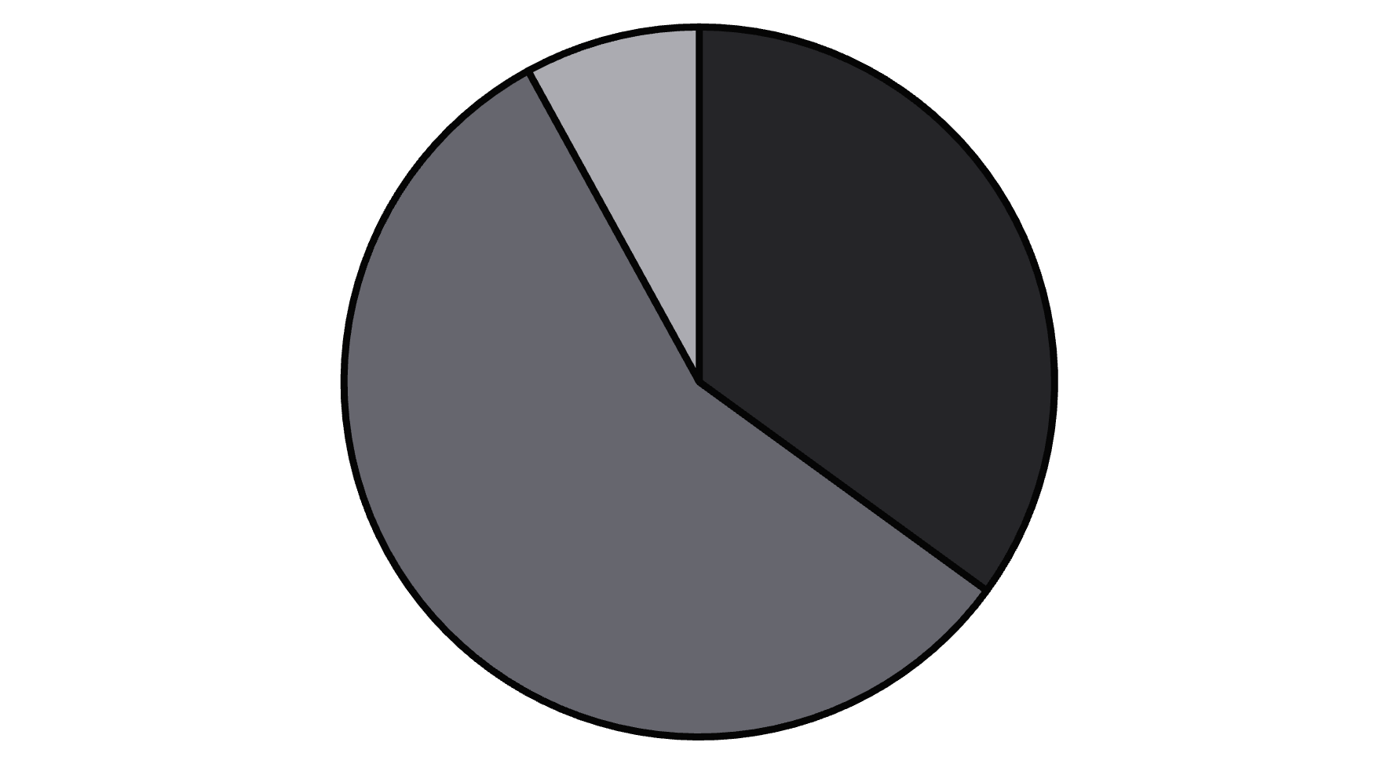
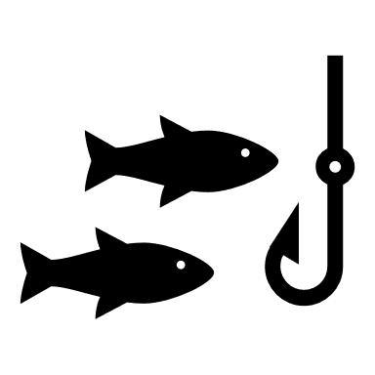
Overfishing and bycatch
Fish stocks are overfished, globally (FDA, 2022)
35%
Overfished
Max Sustainably Fished
Underfished
Destructive fishing methods
Practices like bottom trawling and dynamite fishing cause severe, irreversible damage to marine habitats like coral reefs and the seafloor.
Illegal, unreported and unregulated (IUU) fishing has an annual impact of
$ 23.5 billion

Slide 8
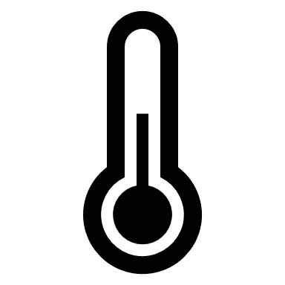


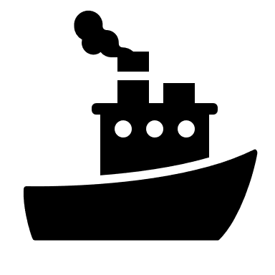
Climate change and ocean acidification
Rising Temperatures
Sea temperatures are increasing, altering fish habitats.
Altered Currents
Pollution and habitat degradation
Oceans are becoming more acidic, harming marine life.
Ocean Acidification
Ocean currents are changing, impacting fish migration patterns.
Coastal development and pollution degrade crucial spawning grounds and vital nursery areas like mangroves threatening marine ecosystems. Destructive fishing practices also damage sea floor habitats.
Undermines sustainable management, depleting fish stocks and damaging habitats due to weak enforcement and illicit activities.

